Slide 1
Computer Networks
Gu Qing, Xia Nai
Nanjing University
2011-9-13

Slide 2
Chapter 7. Network Security
Network Attacks
Cryptographic Technologies
Message Integrity and Authentication
Key Distribution
Transport Layer Security
IP Security
Securing Wireless LANs
Firewalls

Slide 3
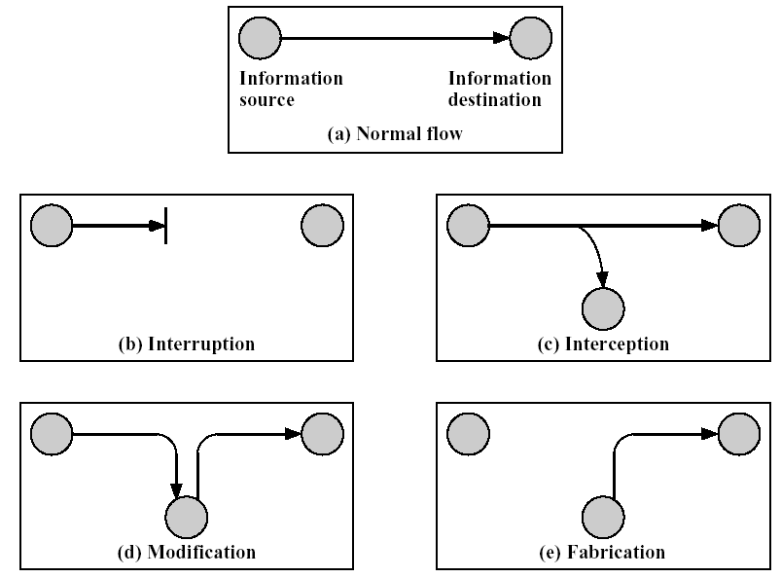
Network Attacks
Release contents
Traffic analysis
Denial of service
Delete files
Masquerade
Replay
Modify contents
Notes:
中断、侦听、修改、伪装

Slide 4
Passive Attacks
Eavesdropping on transmissions
Release of message contents
Traffic analysis
By monitoring frequency and length of msgs between pair of hosts
Nature of communication may be guessed
Difficult to detect, but can be prevented

Slide 5
Active Attacks
Masquerade
Pretending to be a different entity
Replay
Intercept and capture, then retransmit
Modification of message contents
Denial of service
Hard to prevent, but can be detected

Slide 6
Security Requirements
Availability, for Interruption
Ensure resource is available
Confidentiality, for Interception
Only sender, intended receiver can understand the msgs
Integrity, for Modification
Ensure msgs not altered (e.g. in transit) without detection
Authenticity, for Fabrication
Sender, receiver confirm identity of each other and origin of data
Notes:
可用，保密，完整，鉴别

Slide 7
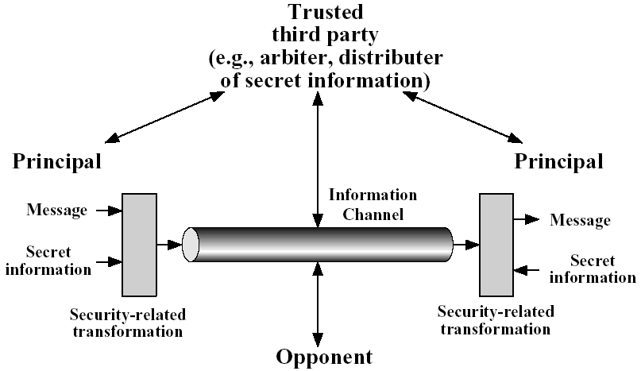
Model for Network Security
Use system security to secure the entities

Slide 8
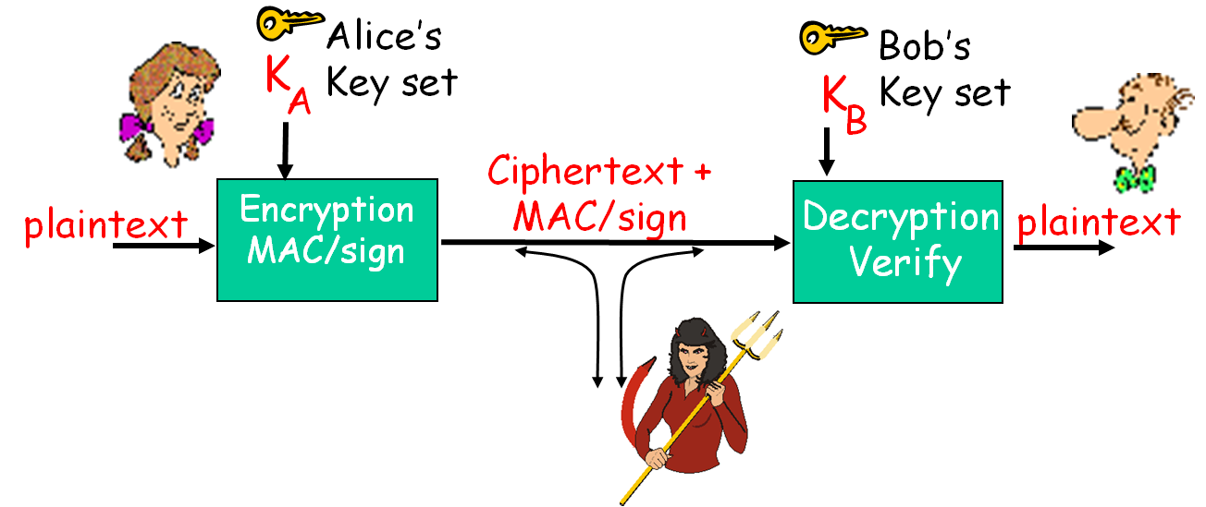
Handling Network Security
Encryption: the message cannot be understood
MAC: the message cannot be altered
Sign: the source cannot be forged/fabricated

Slide 9



Cryptographic Technologies
Alice’s
encryption
key
Bob’s
decryption
key
K
K
A
B
plaintext
encryption
algorithm
ciphertext
decryption
algorithm
plaintext
Symmetric key crypto: sender, receiver keys identical
Public-key crypto: encryption key public, decryption key secret

Slide 10
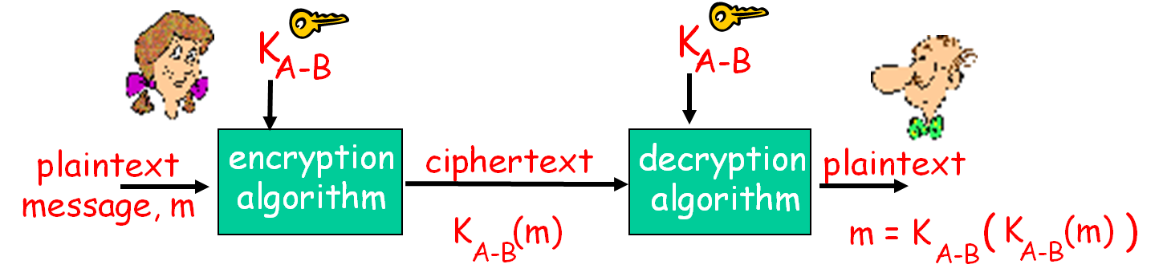
Symmetric Key Cryptography
Bob and Alice share the same (symmetric) key: K_{A-B}

Slide 11
Ingredients
Plain text
Encryption algorithm
Secret key
Cipher text
Decryption algorithm

Slide 12
Requirements for Encryption
Strong encryption algorithm
Even if known, a number of “cipher texts, plain texts” pairs available
Should not be able to decrypt or work out key
Sender and receiver must obtain secret key securely – Key distribution
Once key is known, all communication using this key is readable

Slide 13
Attacking Encryption
Cryptoanalysis
Rely on nature of algorithm plus knowledge of general characteristics of plain / cipher text
Attempt to deduce plain text or key
Brute force
Try every possible key until plain text is achieved

Slide 14
Traditional Encryption Techniques
Substitution methods
Letters of the alphabet are replaced with other letters / numbers / symbols
Caesar Cipher
Mono-alphabetic Cipher
Vigenere Cipher
Transposition (Permutation) methods
Rearrange (shuffle) the input without altering the actual letters used
Rail Fence Cipher
Row-Column Cipher
Notes:
替代 vs. 置换
单字母替代算法

Slide 15
Caesar Cipher (1)
Invented by Julius Caesar, first attested use in military affairs
Cyclic shift of the 26 letters of the alphabet by 3
a | b | c | d | e | f | g | h | i | j | k | l | m | n | o | p | q | r | s | t | u | v | w | x | y | z
d | e | f | g | h | i | j | k | l | m | n | o | p | q | r | s | t | u | v | w | x | y | z | a | b | c
Plain text
attack from east at dawn
Cipher text
dwwdfn iurp hdvw dw gdzq

Slide 16
Caesar Cipher (2)
In mathematical terms
C = encrypt(P) = P+3(mod 26)
P = decrypt(C) = C–3(mod 26)
Generalizd
C = encrypt(P) = P+k(mod 26)
P = decrypt(C) = C–k(mod 26), where 0<k<26
There is only one key
Easy to break, only 26 different keys, use Brute force

Slide 17
Mono-alphabetic Cipher (1)
Map the N letters of the alphabet with one of N! permutations
The key is one of the N! options
a | b | c | d | e | f | g | h | i | j | k | l | m | n | o | p | q | r | s | t | u | v | w | x | y | z
x | f | g | i | k | u | m | o | y | a | c | e | s | v | b | h | d | j | l | p | n | q | z | t | w | r
Plain text
attack from east at dawn
Cipher text
xppxgc ujbs kxlp xp ixzv

Slide 18
Mono-alphabetic Cipher (2)
For N = 26 letters of the English alphabet
There are N! = 26! ≈ 2⁸⁸ possible keys
Attack
Appearance frequency of letters (in long enough texts) in the language is well determined
Fixed substitution
Using the appearance frequencies of letters, words, and pairs-of-letters can easily get the key

Slide 19
Vigenere Cipher (1)
Collection of Mono-Alphabetic Ciphers consists of the 26 options for Caesar Cipher (k = 0, 1, 2, …, 25)
Each of the 26 Caesar Ciphers is denoted by a letter, which is the ciphertext letter that replaces the letter ‘a’
A keyword is used (in cycle) to select which of the Caesar Ciphers to use
Denoted by the current letter in the keyword

Slide 20
Vigenere Cipher (2)
Ciphers Table
 | a | b | c | d | e | f | g | h | i | j | k | l | m | n | o | p | q | r | s | t | u | v | w | x | y | z
a | a | b | c | d | e | f | g | h | i | j | k | l | m | n | o | p | q | r | s | t | u | v | w | x | y | z
b | b | c | d | e | f | g | h | i | j | k | l | m | n | o | p | q | r | s | t | u | v | w | x | y | z | a
c | c | d | e | f | g | h | i | j | k | l | m | n | o | p | q | r | s | t | u | v | w | x | y | z | a | b
d | d | e | f | g | h | i | j | k | l | m | n | o | p | q | r | s | t | u | v | w | x | y | z | a | b | c
 | … … …
Key
bad
Plain text
attack from east at dawn
Cipher text
btwbcn grrn edtt du ddxn

Slide 21
Vigenere Cipher (3)
There are multiple ciphertext letters to which each plaintext letter can be mapped
Number of possible ciphertext letters a plaintext letter can map equals numbers of different letters in key
Attack
Figure out the length of the key
Break each of the suspected Mono-Alphabetic Ciphers independently

Slide 22
Rail Fence Cipher
Plaintext is written down as a sequence of diagonals
Ciphertext is then read of row by row
Plain text
a t c f o e s a d w
t a k r m a t t a n
Cipher text
atcfoesadwtakrmattan
Key is number of rows used
Attack is easy, just play the rows
Notes:
Transposition (Permutation) methods

Slide 23
Row-Column Cipher
Plaintext is written in a rectangle, row by row
Length of each row equal the key length
Ciphertext is read from the rectangle, column by column
Column order corresponds to letter order of the key
Key
noise
34251
Plaintext
3 4 2 5 1
a t t a c
k f r o m
e a s t a
t d o w n
Ciphertext
cmantrsoakettfadaotw
Key can be determined by placing the ciphertext in a rectangle and playing with the rows and the columns
If with plaintext, break pure transposition ciphers is very easy

Slide 24
Modern Encryption Algorithms
Block cipher
Process plain text in fixed block sizes
Produce block of cipher text of equal size
Commonly used Algorithms
Data encryption standard (DES)
Triple DES (TDES)
Advanced Encryption Standard (AES)
Notes:
Stream cipher: process plain text letter by letter

Slide 25
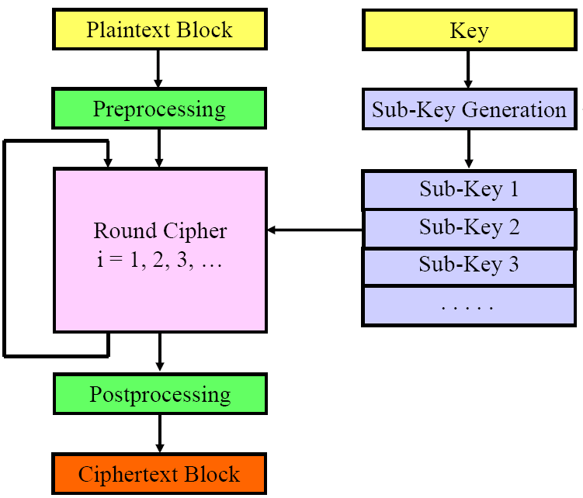
Pattern of Block Ciphers

Slide 26
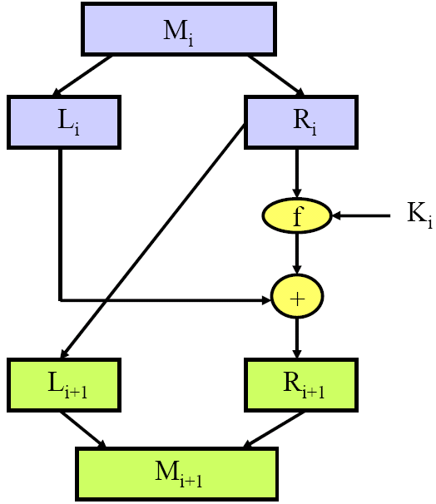
Feistel Ciphers
A scheme / template for specifying the algorithm of a block cipher
Allows encryption and decryption with the same hardware circuit / piece of software
Input block M_{i} broken into half-blocks L_{i} and R_{i}
For next round
L_{i+1} = R_{i}
R_{i+1} = f(R_{i}, K_{i}) ⊕ L_{i}
Notes:
A class of algorithms

Slide 27
Data Encryption Standard
1973, NBS (National Bureau of Standards) came out with an RFP for a commercial encryption standard
IBM proposed its strong Lucifer algorithm (developed by Feistel and others)
NSA (National Security Agency) requested to weaken the strength of Lucifer (by shortening the key)
NSA also made changes to IBM’s Lucifer algorithm
1976, Data Encryption Standard (DES) accepted
1999, Triple DES (3-DES) defined by NIST (National Institute of Standards and Technology)
Notes:
Request for Proposal
三重DES

Slide 28
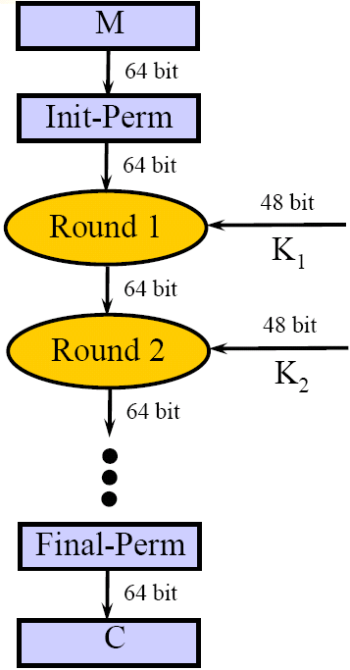
DES Structure
Block size – 64 bits
Key size – 56 bits (in a 64-bit buffer)
Fixed initial permutation on input block (64 bits)
16 round keys (48 bits) derived from key (56 bits)
Key scheduling scheme for 16 round keys
16 iterations each consisting of scrambling the round-block (64 bits) with the round-key (48 bits)
Fixed inverse initial permutation on output block
Notes:
明文块

Slide 29
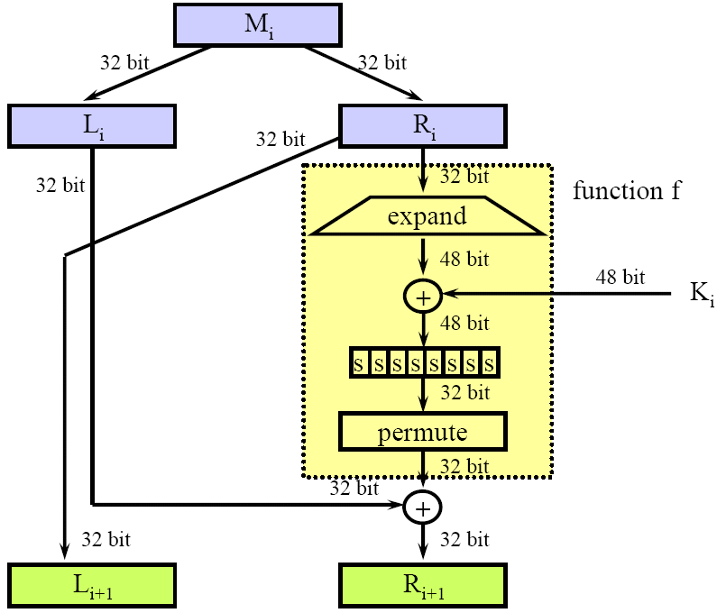
Per Round DES
Scramble function:
6 inputs / 4 outputs
8 S-Box

Slide 30
Attack DES
Exhaustive Search Attack
Search space of O(2⁵⁶) = O(10¹⁷) keys
No “backdoor” exists
DES now worthless
In the 1970’s, Diffie and Hellman suggested a $20M machine that will crack DES in about one day
In the 1990’s, Wiener suggested a $1M machine that will crack DES in 3.5 hours
In 1990’s, DES challenges were broken in matter of days using distributed clusters of computers
Presumably, most national security agencies have the hardware and software to crack DES in hours

Slide 31
Triple DES
1985, ANSI X9.17
1999, Incorporated into DES standard
Uses 3 keys and 3 executions of DES algorithm
2 Mode defined
EEE mode
EDE mode
Problem
Slow, block size (64 bit) too small
Notes:
American National Standards Institute, 美国国家标准学会

Slide 32
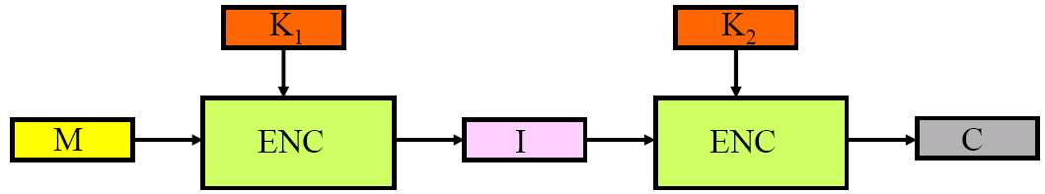
3-DES: EEE Mode
DES Encrypt-Encrypt-Encrypt with 3 keys K₁, K₂, and K₃
Properties
Three keys (168 bits)
Strength about O(2¹¹⁰) against attack
Not compatible with regular DES

Slide 33
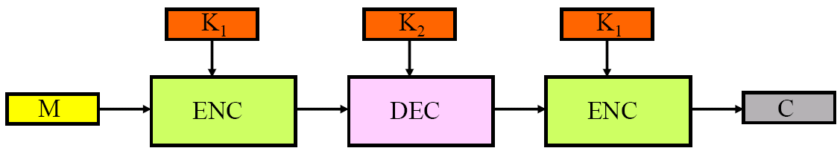
3-DES: EDE Mode
DES Encrypt-Decrypt-Encrypt with 2 keys K₁ and K₂
Properties:
Two keys (112 bits)
Strength about O(2¹¹⁰) against attack
Compatible with regular DES when K₁= K₂
Can Encrypt-Decrypt-Encrypt with keys K₁, K₂, and K₃, more resilient against attacks

Slide 34
Advanced Encryption Standard
1997, NIST published RFP for Advanced Encryption Algorithm
Symmetric block cipher
Security strength equal to or better than 3-DES with improved efficiency
Variable strength by key size (from 128 to 256 bits)
Efficient implementation on various SW & HW platforms
About 20 algorithms were proposed
Open review process for about 3 years
Rijndael was selected in November 2001
2001, AES issued as federal information processing standard (FIPS 197)

Slide 35
AES Parameters
B: Block size in 32-bit words, 4 means 128 bits
K: Key size in 32-bit words, 4 / 6 / 8 (i.e. 128 / 192 / 256 bits)
r: Number of rounds – 6 + max(B, K)
AES-128 – 10 rounds
AES-192 – 12 rounds
AES-256 – 14 rounds

Slide 36
AES Description
State Array
A rectangular array of 4 rows by B (=4) columns
Each of the array entries holds an octet (8 bits)
Initial value of state array is the plaintext block entered column by column
State is transformed during r rounds
Final value of state is the ciphertext block read column by column
key-expansion scheme
Key is organized as a sequence of key-sets
Initial key-set consists of K columns of 4 octets (32 bits) each
Key-expansion generates (r+1)×B 4-octet columns
Notes:
If r = 10, 44×32bits expanded from initial key

Slide 37
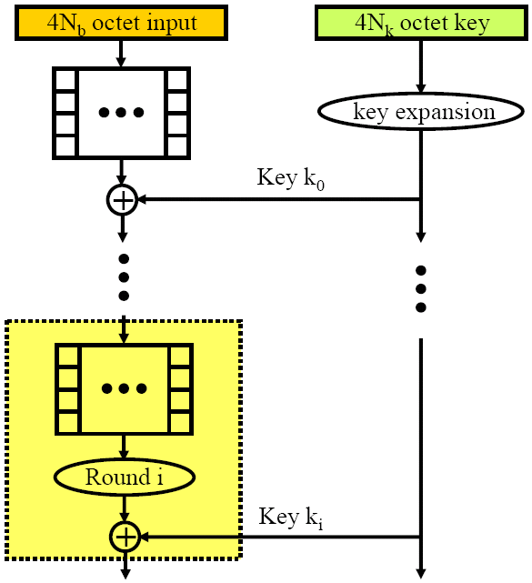
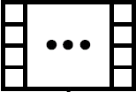
Per Round AES (1)
4×B octet input
Placement of input in the state array
4×K octet key
Key expansion
XOR input with K₀
r rounds of state array transformation and XOR with K_{i}

Slide 38
Per Round AES (2)
4 primitive operations inside each round
S-box that substitutes octet for octet, S-box substitution is implemented as a table lookup
Rearrangement of octets that consists of rotating rows by some number of cells
A Mix-Column operation that replaces a 4-octet column with another 4-octet column, uses table lookup
Bit-wise XOR with current K_{i}

Slide 39
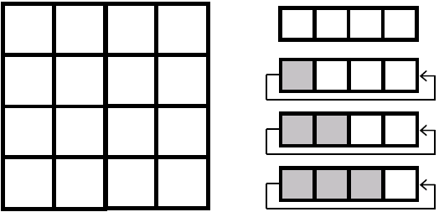
Row Rotations
4×B cells of 8 bits each
Row 0 of the state array is not rotated
Row 1 of the state array is rotated left 1 column
Row 2 of the state array is rotated left 2 columns
Row 3 of the state array is rotated left 3 columns

Slide 40
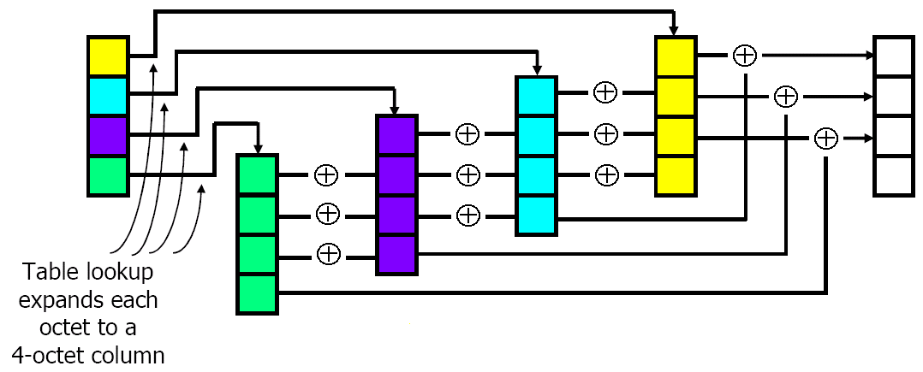
Mix-Column Operation
On each 4-octet column
A new 4-octet column is computed

Slide 41
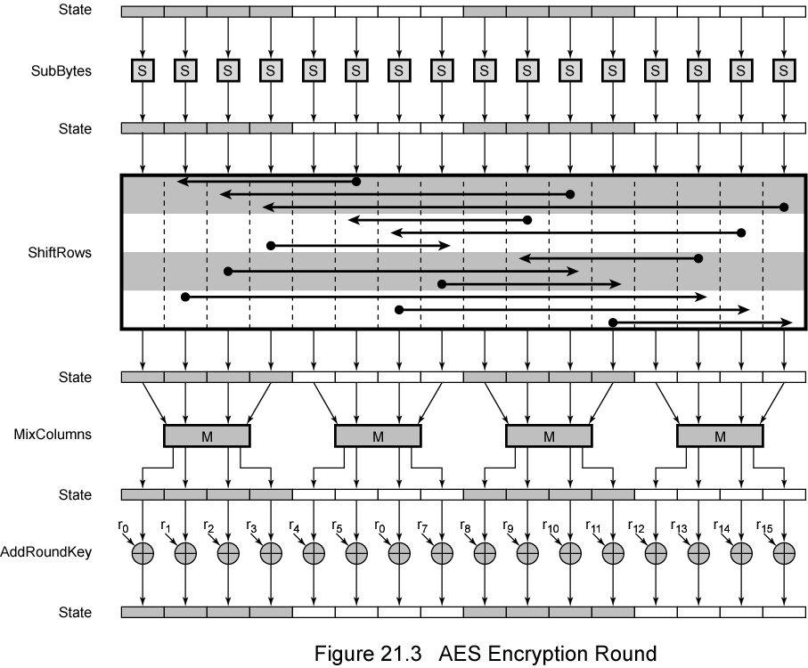
AES Encryption Round

Slide 42
AES Description
Simple structure
For both encryption and decryption, cipher begins with Add Round Key stage
Followed by r–1 rounds, each includes all 4 operations
Followed by last round of 3 operations
Add Round Key plus 3 operations of scrambling bits
Decryption uses expanded key in reverse order
Not identical to encryption algorithm

Slide 43
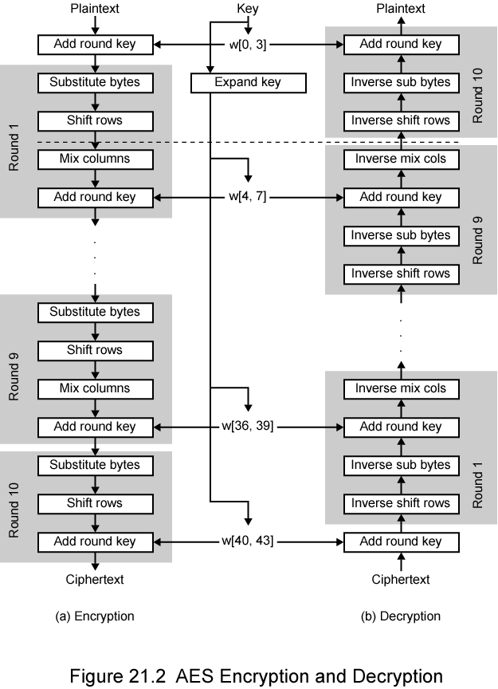
AES Structure
128 bit key
r = 10

Slide 44
Public Key Cryptography
Radically different approach
Based on mathematical algorithms
Asymmetric keys
Use two separate keys
Sender, receiver do not share symmetric secret key
Each end system has
A public encryption key known to all
A private decryption key only the owner knows

Slide 45
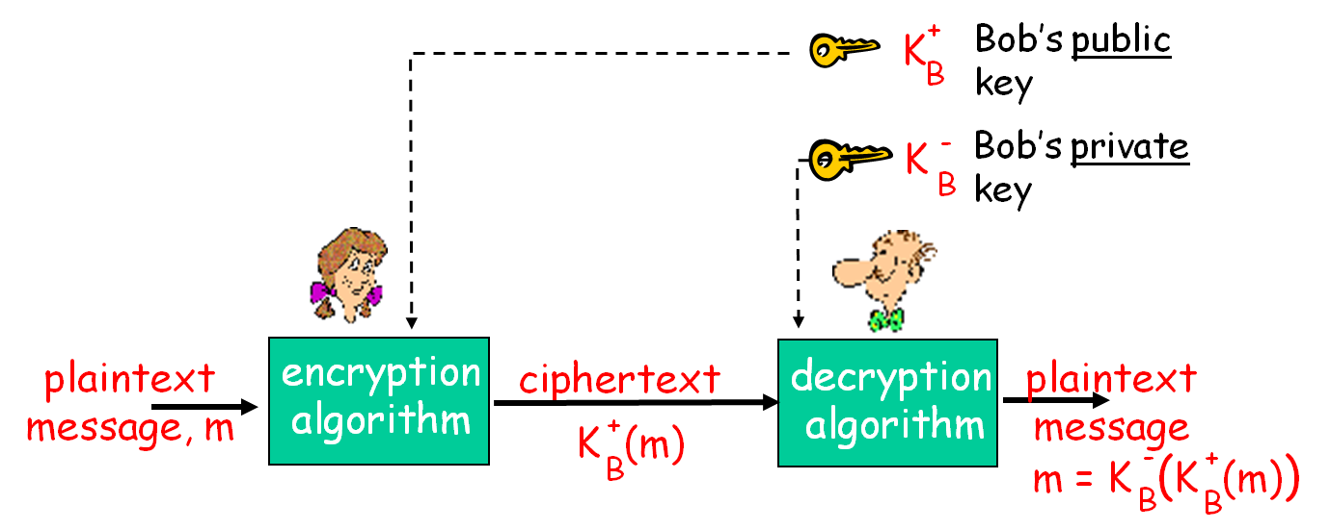
Public Key Cryptography
Bob and Alice both have their own key sets

Slide 46
Public Key Ingredients
Plain text
Encryption algorithm
Public and private key
Cipher text
Decryption algorithm

Slide 47
Public-Key Model
Entity A has two keys
PRV_{A} – Private Key of A, kept secretly only at A
PUB_{A} – Public Key of A, made public to all
There are two functions
Encrypt – uses one of the two keys
Decrypt – uses the other key
Such that
Decrypt(Encrypt(M, PUB_{A}), PRV_{A}) = M
Decrypt(Encrypt(M, PRV_{A}), PUB_{A}) = M

Slide 48
Public Key Requirements
The algorithms of encryption and decryption functions should be known
Given the public key and the algorithms, it should be hard to find the private key
Given a cipehrtext using the public key, it should be hard to get the plaintext
Given pairs of (plaintext, ciphertext) with the public key, it should be hard to find the private key

Slide 49
RSA Algorithm
1977, Rivest, Shamir, Adleman algorithm
Pick 2 large primes : p and q
About 500/1024 bits each
Compute : N = p × q
Compute : Φ = (p–1)×(q–1)
Pick e relatively prime to Φ, i.e. GCD(e, Φ) = 1
Calculate d inverse of e modulo Φ, i.e. d×e mod Φ = 1
The key set is ready
Public Key: (e, N), and Private Key: (d, N)
Notes:
Greatest common divisor

Slide 50
RSA Encryption & Decryption
Euler’s Theorem
(Me mod n)^{d} mod n = M^{ed} mod n = M(mod N)
Encryption
Use public-key (e, N) to encrypt message block M<N
C = Me(mod N)
Send only C
Decryption
Use private-key (d, N) to decrypt cipher C<N
M = C^{d}(mod N)

Slide 51
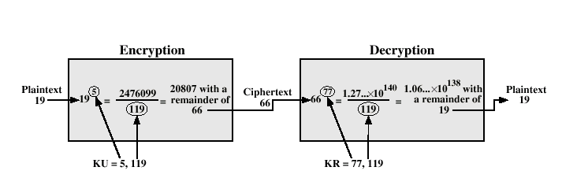
RSA Example
M
C
M
N
e
d
Notes:
119 = 7×17

Slide 52
RSA Considerations
Primes p and q should be of about the same length
About half the length of N
Primes p and q should be unrelated
Public exponent e can be small
No need to add much burden on encryption
Private exponent d must be large
Disallow searching on small values (brute force)
Strength of RSA depends on the fact that
Large N with large prime factors, factoring is a hard problem
N’s length can be enlarged to make it stronger

Slide 53
More about RSA
The other way around
(M^{d} mod n)^{e} mod n = Mde mod n = M(mod N)
Signature
A use private-key (d, N) to sign message block M<N
S = M^{d}(mod N)
Send M and S
Verification
B (and others) use public-key (e, N) to check signature S on message M
S^{e} = M (mod N)
This authenticate A, since only A has the private key

Slide 54
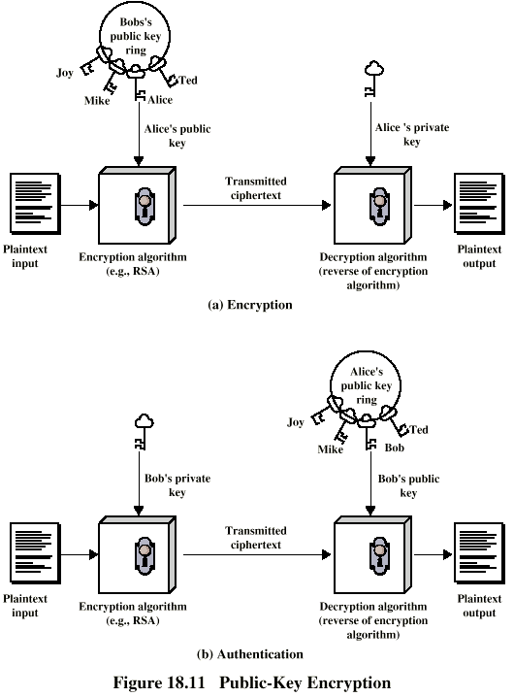
Public Key for Encryption
C = Encrypt(M, PUB_{A})
M = Decrypt(C, PRV_{A})

Slide 55
Public Key for Authentication
C = Encrypt(M, PRV_{A})
M = Decrypt(C, PUB_{A})

Slide 56
Message Integrity and Authentication
Receiving msgs from Alice, Bob wants to ensure:
Message originally came from Alice
Message not changed since sent by Alice
Security handling
Source impersonation / spoofing
Message injection / modification
Message re-sequencing / replaying

Slide 57
Authentication Functions
Creating an authenticator which may involve functions of
Sender / Message Text
Time Stamp / Sequence Number / Random Value
Secret Keys
The sender computes and sends the authenticator as part of the regular message
The recipient compares the received authenticator with the expected authenticator
Notes:
=鉴别码

Slide 58
Message Authentication Code
(shared secret)
s
H(m+s)
MAC(.)
(message)
m
m
H(m+s)
public
Internet
m
append
compare
H(m+s)
MAC(.)
H(m+s)
s
(shared secret)

Slide 59
Authentication by MAC
MAC is a fixed-size code that is appended to the message
Typical sizes of MAC range from 64 to 256 bits
Message can be sent in the clear without encryption
MAC is a function of the message and a secret key
Can assure msg not altered, and from alleged sender
MAC should not be reversible, decryption is not needed
The strength of the MAC depends on the function and on the secrecy of the key
Notes:
Message Authentication Code
If message has sequence number, receiver assured of proper sequence
控制信息直接包含在消息首部

Slide 60
Authentication Methods
Authentication by Crypto
Using crypto functions of the text and secret keys
CBC-MAC
Authentication by Hash
Using hash functions and involving secret keys in the computations
MD5, 128 bit MAC, (RFC 1321)
SHA-1, 160 bit MAC, (NIST, FIPS PUB 180-1)
Notes:
MAC: Message Authentication Code

Slide 61
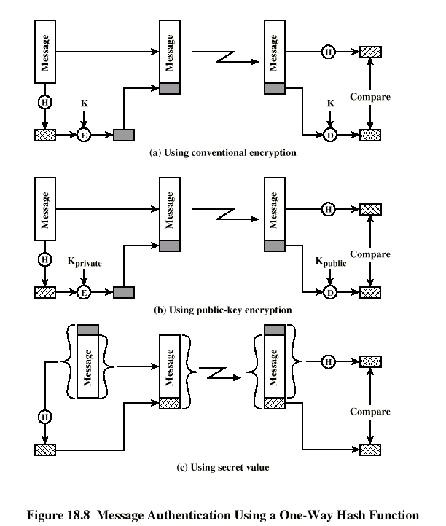
MAC Options
Preferred
Notes:
方式2用于认证
3用于鉴别

Slide 62
Requirements of MAC Functions
Operability
Work on any input length
Produce output of fixed size
Should be easy to compute
Security
One-way – given value Y, it is hard to find content X such that Y = MAC(X)
Weak Collision Resistance – given content X₁ it is hard to find another content X₂ such that MAC(X₁) = MAC(X₂)
Strong Collision Resistance – it is hard to find any two different contents X₁ and X₂ such that MAC(X₁) = MAC(X₂)

Slide 63
CBC-MAC Authentication
Divide message M into L blocks of size n bits each
M = M₁, M₂, . . ., M_{L}
Let K be a secret key of the encryption algorithm E
Let C₀ = IV be a random block of n’ bits
Compute C_{i} = E_{K}(M_{i} C_{i–1}) for i = 1, 2, . . ., L
CBC-MAC_{K}(M) = C_{L}
Let MAC_{K}(M) = (C₀, C_{L}) = (IV, CBC-MAC_{K}(M))
i.e. the first and last blocks of CBC encryption

Slide 64
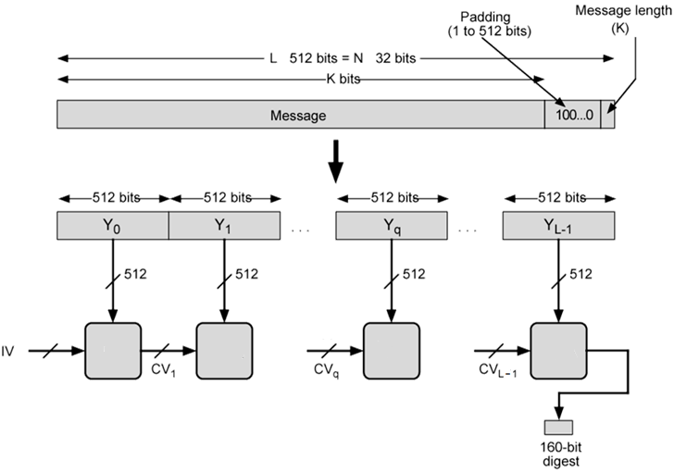
Common Structure for MD5 and SHA-1
×
×
H
H
H
H

Slide 65
Common Steps
Input message less than 2⁶⁴ bits
Processed in 512 bit blocks
Appends padding bits
Message Length congruent to 448(mod 512)
Adds length field
Original message length is written in last 64 bits

Slide 66
MD5 Processing
Uses 4-word state buffer A, B, C, D to compute the message digest
Initial value: 01234567, 89abcdef, fedcba98, 76543210
Total 128 bits
Process message in 16-word blocks
M₀, M₁, … M₁₅
Processing of a msg block consists of 4 similar stages
Each with a different function F
Each stage is composed of 16 similar operations
Using F, modular +, and left rotation
Notes:
National Institute of Standards and Technology

Slide 67
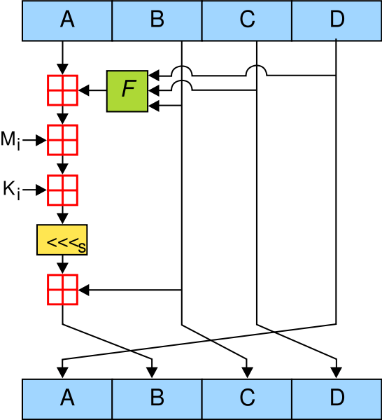
One MD5 Operation
A different F is used for each stage
M_{i} is a 32-bit word of msg
K_{i} is a 32-bit generated constant

Slide 68
SHA-1 Processing
Uses 5 word state buffer A, B, C, D, E to compute the message digest
Value 67452301, efcdab89, 98badcfe, 10325476, c3d2e1f0
Total 160 bits
Process message in 16-word chunks
M₀, M₁, … M₁₅
Processing of a msg block consists of 4 similar stages
Each with a different function F
Each stage is composed of 20 similar operations

Slide 69
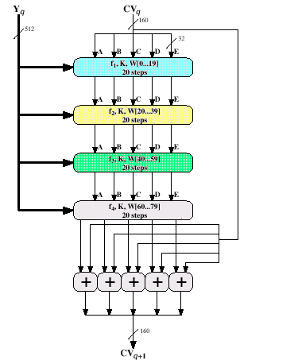
SHA for A Single Chunk
M₀, M₁, …, M₁₅ : 16 words of input chunk
For t = 0 to 15, W_{t} = M_{t}
For t = 16 to 79, W_{t} = S¹(W_{t–16} ⊕ W_{t–14} ⊕ W_{t–8} ⊕ W_{t–3})
F₁, F₂, F₃, F₄ : 4 different elementary functions
K : distinct set of constants for each F_{i}
Notes:
S^{i} : Circular Left Shift by i bits

Slide 70
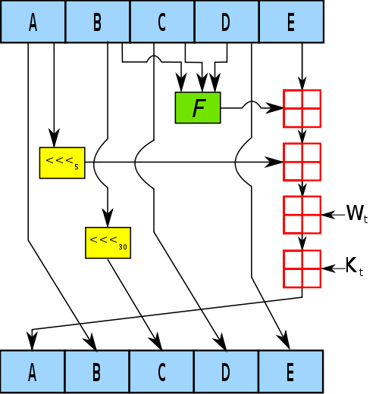
One SHA Operation
F is a nonlinear function that varies
W_{t} is the expanded message word of step t
K_{t} is the constant of step t

Slide 71


Digital Signature
Sender (Bob) digitally signs document, making him document owner/creator
Recipient (Alice) can prove to someone that Bob, and no one else, must have made the document
-
Bob’s private
key
-
Bob’s message, m
K
m +
K
(m)
B
B
public key
encryption
algorithm
Bob’s private key is essential

Slide 72
Digital Signature is Signed MAC
Alice verifies signature and integrity of digitally signed message:
Bob sends digitally signed message:
large
message
m
H: hash
function
encrypted
msg digest
H(m)
-
K_{B}(H(m))
Bob’s
private
key
digital
signature
(encrypt)
large
message
m
-
Bob’s
public
key
digital
signature
(decrypt)
K
B
+
H: hash
function
K
encrypted
msg digest
B
+
-
K_{B}(H(m))
H(m)
H(m)
equal
?

Slide 73
Key Distribution
Problem
How can Alice and Bob share the common secret key
How does Alice know Bob’s public key does be Bob’s public key
Solution
Diffie-Hellman Key Exchange
Trusted certification authority (CA)
Certificate for public key

Slide 74
Attack Key Distribution
Alice’s
IP addr
Secret info
“I’m Alice”
Alice’s
IP addr
OK
Alice’s
IP addr
Secret info
“I’m Alice”
Record and playback
Still account for large part of secret holes
Needs proper use of timestamp and nonce

Slide 75
Attack Key Distribution
Key Exchange
Key Exchange
Msg Exchange
Msg Exchange
Middle attack
Trudy poses as Alice (to Bob) and as Bob (to Alice)
Hard to detect
Bob receives everything that Alice sends, and vice versa
But Trudy receives all messages as well!

Slide 76
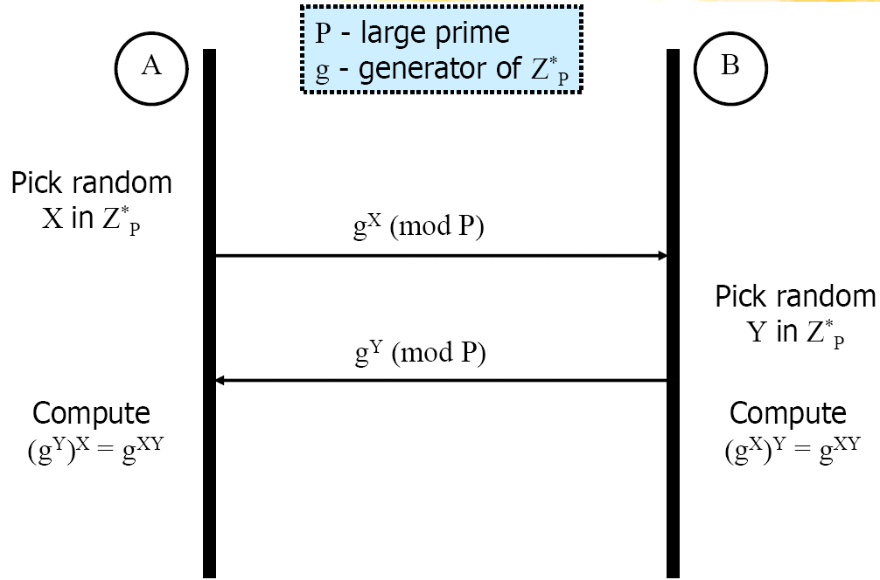
Diffie-Hellman Key Exchange (1)
Preliminary
Large prime P known to the world
Generator g of Z_{p}* known to the world
A and B do not share any secret value
Notes:
Z_{p}* = {0, 1, 2, …, p-1}(mod p)
Discrete Log Problem

Slide 77
Diffie-Hellman Key Exchange (2)
The D-H Protocol
A picks at random a number X ∈ {1, 2, …, P–1} and sends to B the value g^{X}(mod P)
B picks at random a number Y ∈ {1, 2, …, P–1} and sends to A the value g^{Y}(mod P)
A computes (g^{Y})^{X} (mod P) = g^{XY}(mod P)
B computes (g^{X})^{Y} (mod P) = g^{XY}(mod P)
A and B now share the secret value g^{XY}(mod P)
Note:
Z_{P}* = {1≤a≤P–1: gcd(a,P)=1}
Each [a] denote a set [a] = {a+k×P: k∈Z}
For a prime P, Z_{P}* = {1, 2, …, P–1}
Generator g of Z_{P}*: g∈Z_{P}*
∀a∈Z_{P}*, ∃k∈Z, a = g^{k}(mod P)
Notes:
Z: 整数集
幂值

Slide 78
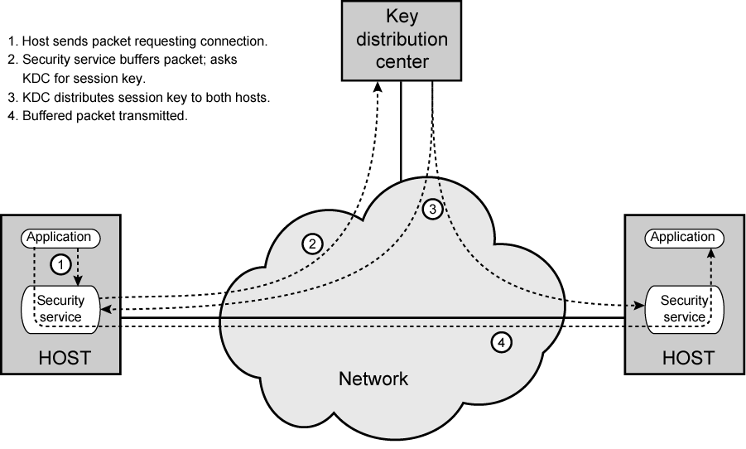
Trusted Certification Authority

Slide 79
Key Distribution via CA
Session Key
Used for duration of one logical connection
Destroyed at end of session
Permanent key
Used for distribution of keys
Key distribution center (CA)
Determines validity of sender and receiver
Provides one session key for that connection
Security service module (SSM)
Performs end to end encryption
Obtains keys for host

Slide 80
The Needham-Schroder Protocol
AS
ticket
1: C, S, N_{c}
2: K_{c-as}( N_{c}, S, K_{cs}, K_{s-as}(K_{cs}, C) )
3: K_{s-as}(K_{cs}, C)
C
4: K_{cs}(N_{s})
S
5: K_{cs}(N_{s}-1)
AS: Authentication server (KDC) C: client
S: server
K_{x-as}: key shared between X and AS, where X is C, or S K_{cs}: session key between client C and server S
N_{x}: Nonce generated by X
Notes:
消息1用C的私钥加密
防止重放攻击

Slide 81
One-Time Session Key
Public key not suitable for large blocks of message
Bob communications with Alice by following steps
Prepares a message
Encrypts the message using symmetric crypto with a one-time session key
Encrypts the session key using Alice’s public key
Attaches the encrypted session key to the message and sends it to Alice
Alice gets the session key using her private key, and decrypts the message

Slide 82
Public Key Certificate
Question
How to ensure the published public key does be Alice’s public key, not from someone else
Solution: Public key certificate
A public key plus User ID of the key owner
Above block signed by a trusted CA with a timestamp
Others cannot substitute Alice’s public key with his own
Cannot forge the signature of the trusted CA
Notes:
Certification Authority

Slide 83
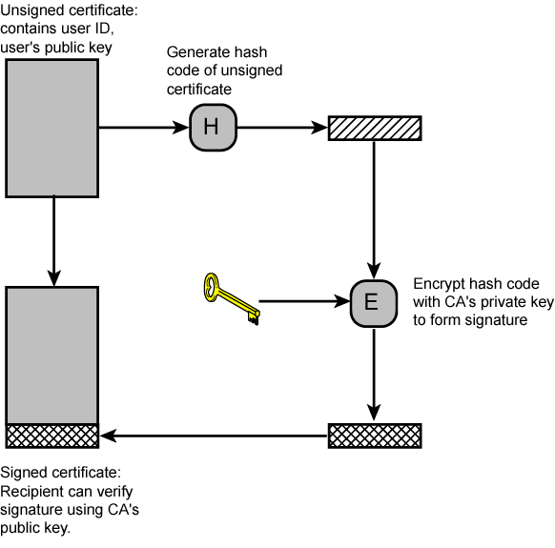
Public Key Certificate
+
K
B
Notes:
CA: Certificate Authority

Slide 84
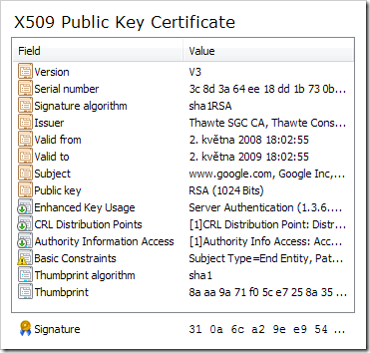
Public Key Certificate
Serial number (unique to this certificate)
Info about certificate owner, including algorithms and key value
Info about certificate issuer
Including valid dates, digital signature by issuer (thumbprint / fingerprint)
Notes:
CRL: certificate revocation list

Slide 85
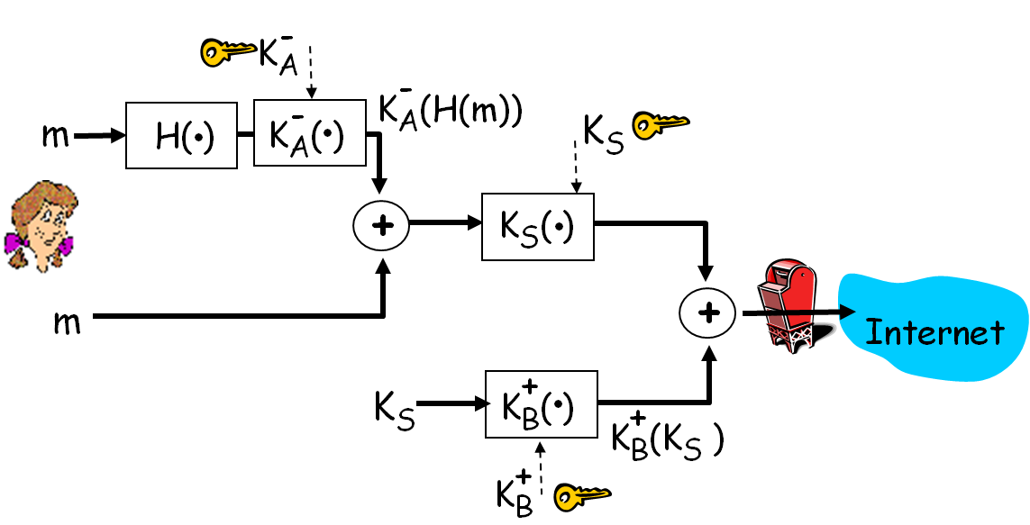
An Example: Secure Email
Alice wants to provide secrecy, sender authentication, and message integrity
Internet e-mail encryption scheme, de-facto standard
Alice uses three keys: her private key, Bob’s public key, newly created symmetric key

Slide 86
Transport Layer Security
SSL – Secure Sockets Layer
Used by Netscape
1996, SSL v3 was created with public review from industry
IETF started with this version to develop a common standard
TLS – Transport Layer Security
1999, RFC 2246 by IETF
Essentially SSL v3.1 with minor difference
Notes:
IETF: Internet Engineering Task Force

Slide 87
SSL/TLS Characteristics
Protects application traffic for all applications that are SSL/TLS aware
Applications must be SSL enabled by design
Typical applications
http (https) in web browsers
IMAP (Internet Message Access Protocol, for email like POP3)
LDAP (Lightweight Directory Access Protocol)
802.1x authentication
Many VPN systems use SSL/TLS to send encrypted traffic
Mandatory server authentication
Client checks server’s certificate, also against CRLs (certificate revocation lists)
Client authentication supported but normally not used
Notes:
比Socket API复杂

Slide 88
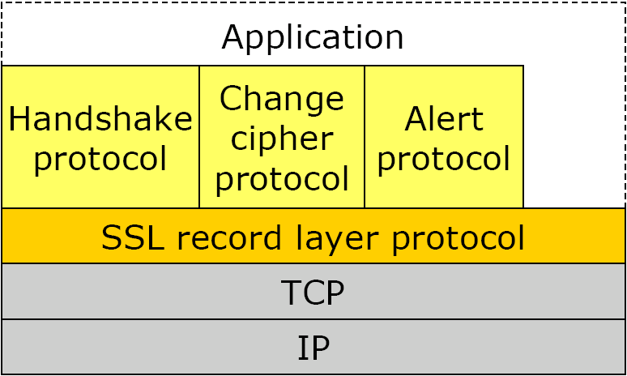
SSL Architecture
SSL resides on TCP to provide reliable end-to-end secure service
2 layers of protocols
Record Protocol provides basic security services to various higher-layer protocols
Underlying protocol suite, transparent to applications
3 higher-layer protocols for management of SSL exchanges
Embedded in specific packages, within IE or Netscape

Slide 89
SSL Session
Association between client and server
Created by Handshake Protocol
Each with a set of cryptographic security parameters
Peer’s (Server) certificate, for public keys
A master secret of 48 octets, for shared keys
Compression, cipher or MAC (hash) to use
May have many (TCP) connections within
Used to avoid negotiation of new security parameters for each connection
Multiple sessions between same pair of apps are supported (not used)

Slide 90
SSL Connection
Mechanisms used to transport data in a session
A connection is associated with
Shared keys to encipher data and compute MAC
IV for MAC if needed
Sequence numbers
Peer-to-peer and Transient
Every connection associated with one session

Slide 91
SSL Record Protocol
Each upper-layer message fragmented
2¹⁴ octets (16384 octets) or less
Compressed message plus MAC encrypted using symmetric encryption
Compression optionally applied
Add SSL record header, PDU transmits in TCP segment
Notes:
message authentication code

Slide 92
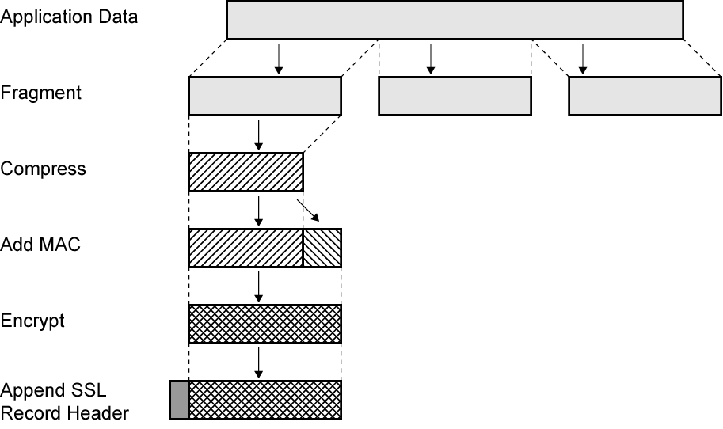
SSL Record Protocol Operation
Optional
Received data are decrypted, verified, decompressed, and reassembled

Slide 93
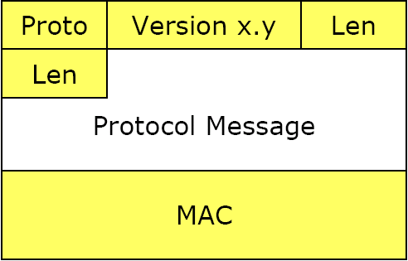
SSL Record PDU
Protocol Type (1 octet)
20: change_cipher_spec, 21: alert, 22: handshake, 23: application
No distinction between applications
Major Version (1 octet)
SSL v3 is 3
Minor Version (1 octet)
SSL v3 is 0
Compressed Length (2 octets)
Per octet, maximum 2¹⁴+2048
MAC (0, 16, or 20 octets)

Slide 94
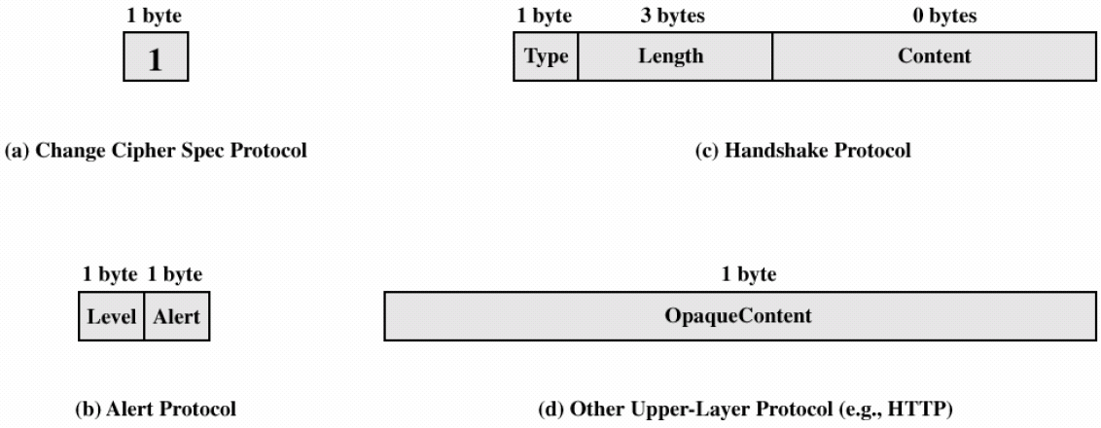
SSL Application Protocols

Slide 95
Change Cipher Spec Protocol
Single octet message
Set value 1
Cause current state to be the pending (negotiated) state
Cipher suite updated to use on this connection
Notes:
i.e. new Cipher Spec

Slide 96
Alert Protocol
Convey SSL-related error or alerts to peer entity
Alert messages compressed and encrypted
Alert level
1: warning, 2: fatal
If fatal, SSL immediately terminates connection
Other connections on session may continue but no new connections accepted on session
Alert description, e.g.
Fatal: UnexpectedMessage, BadRecordMAC, HandshakeFailure
Warning: CloseNotify, Certificate Unsupported/Revoked, Illegal Parameter

Slide 97
Handshake Protocol
Purpose
Authenticate sender/receiver
Negotiate encryption and MAC algorithm and cryptographic keys
4 rounds
Create SSL connection between client and server
Establish security capabilities
Server authenticates itself
Presents public key suitable for shared key distribution
Client validates server, begins key exchange
Acknowledgments all around
Change cipher according to agreement

Slide 98
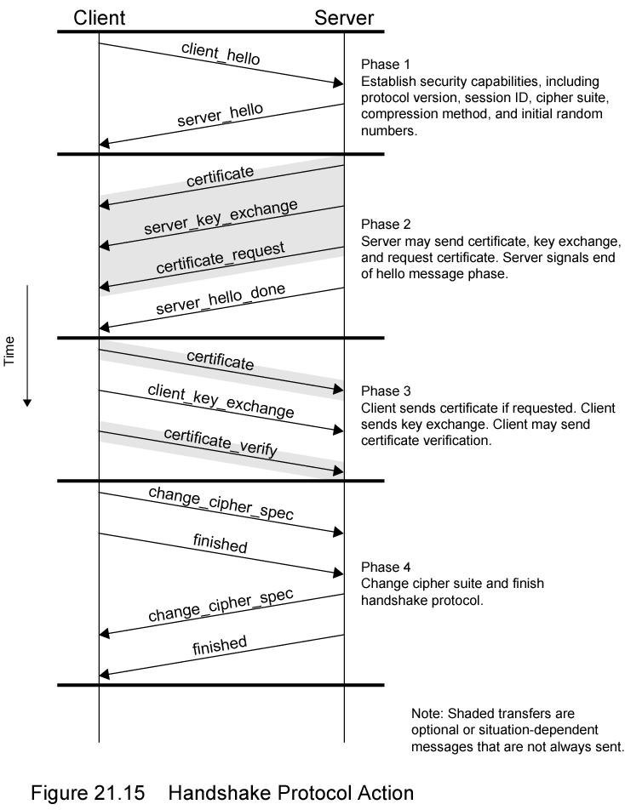
Handshake Protocol Actions

Slide 99
Round 1: Initiate Connection (1)
Version
Highest SSL version understood by client
Random
Client-generated nonce
32-bits timestamp and 28 octets from secure random number generator
Used during key exchange to prevent replay attacks
Session ID
Variable-length
Nonzero indicates client wishes to update existing connection or create new connection on old session
Zero indicates client wishes to establish new connection on new session

Slide 100
Round 1: Initiate Connection (2)
CipherSuite
List of cryptographic algorithms supported by client
Each element defines key exchange algorithm and CipherSpec
Compression Method
Compression methods client supports

Slide 101
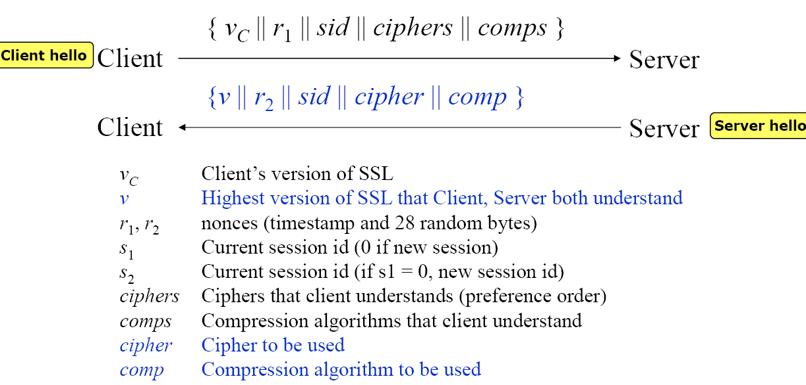
Round 1 Illustration
Notes:
加密与否取决于Record协议

Slide 102
Round 2 and 3
Round 2 depends on underlying encryption scheme
Server certificate is required on new session
Round 3
Client verifies certificate if needed and check server_hello parameters
Client sends secrets to server, depending on underlying public-key scheme
Notes:
Round 2：服务器交换“公共密钥”
Round 3：客户端交换“session密钥”

Slide 103
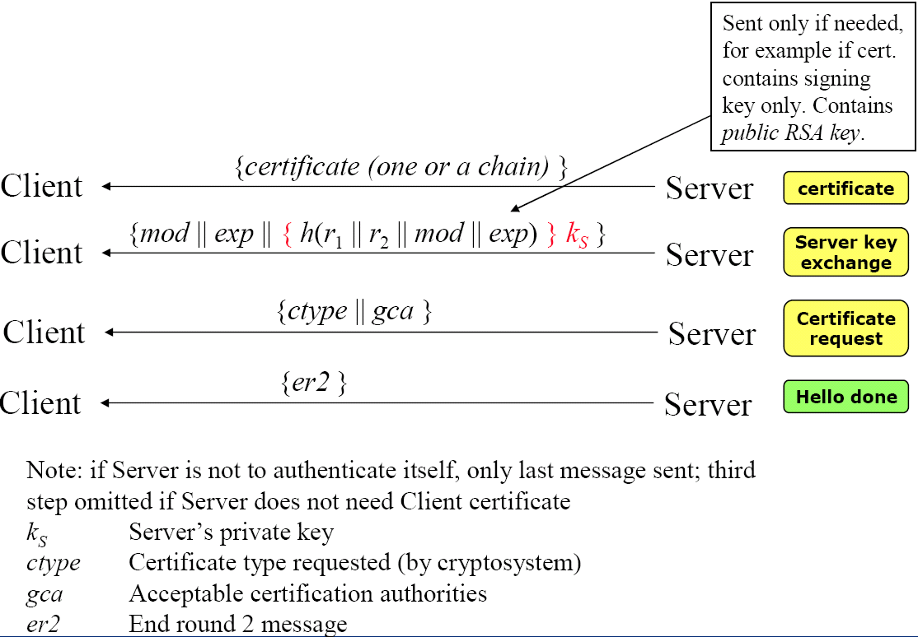
Round 2 Illustration
Notes:
mod: temporary server public RSA key
exp: time for expiration
k_{s}: server signature key

Slide 104
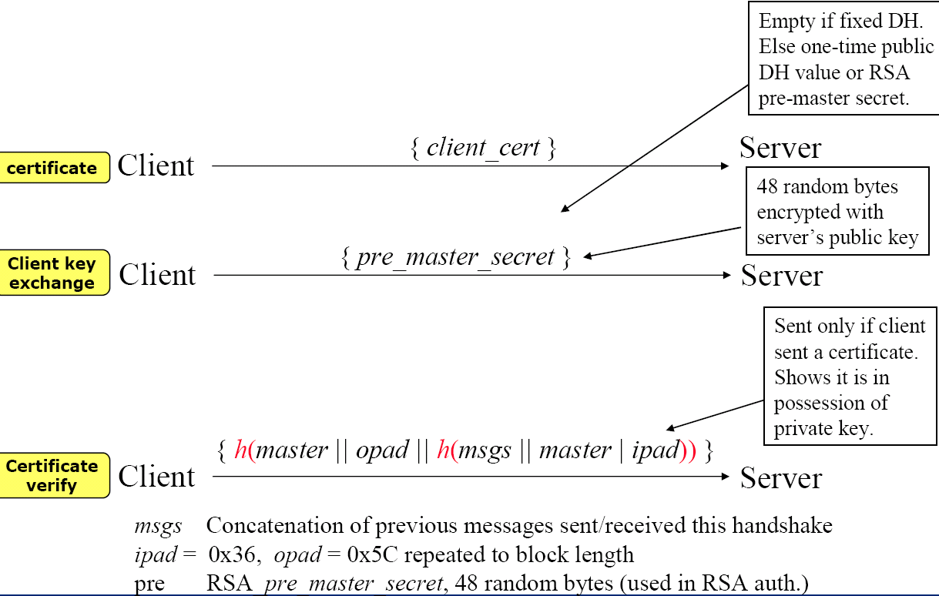
Round 3 Illustration
Notes:
DH: Diffie & Hellman
Both the client and the server generate the symmetric encryption keys on their own using the pre_master_secret and the random data that is generated from the SERVER_HELLO and CLIENT_HELLO commands
If the server does have the requested session ID in its SSL cache, the server echoes that session ID in its SERVER_HELLO command. The client and the server then create new encryption keys based on the cached parameter secret and the new random data from this SSL handshake

Slide 105
Round 4
Client sends change_cipher_spec
Copies pending CipherSpec into current CipherSpec
Sent using Change Cipher Spec Protocol
Client sends finished message under new algorithms, keys, and secrets
Finished message verifies key exchange and authentication successful
Server sends own change_cipher_spec message
Transfers pending CipherSpec to current CipherSpec
Sends its finished message
Handshake complete

Slide 106
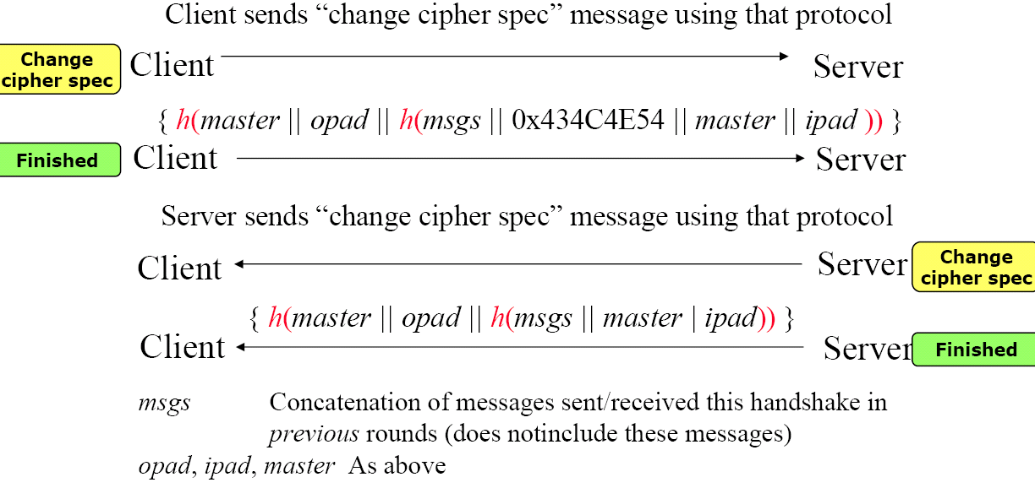
Round 4 Illustration

Slide 107
IPSec
Encryption of traffic at IP level
Transparent for transport layer (TCP, UDP)
De-facto standard for site-to-site VPNs
Mandatory in IPv6, optional in IPv4
Application examples
Branch office connectivity over the Internet
Secure remote access (user to site)
Extranet and intranet connectivity
Server to server traffic encryption
Enhanced electronic commerce security
Notes:
Virtual Private Network

Slide 108
IPSec Scope
RFC 2401: Overview of security architecture
RFC 2402: Authentication Extension
Authentication header
RFC 2406: Encryption Extension
Encapsulated security payload
RFC 2408: Key management
Key exchange

Slide 109
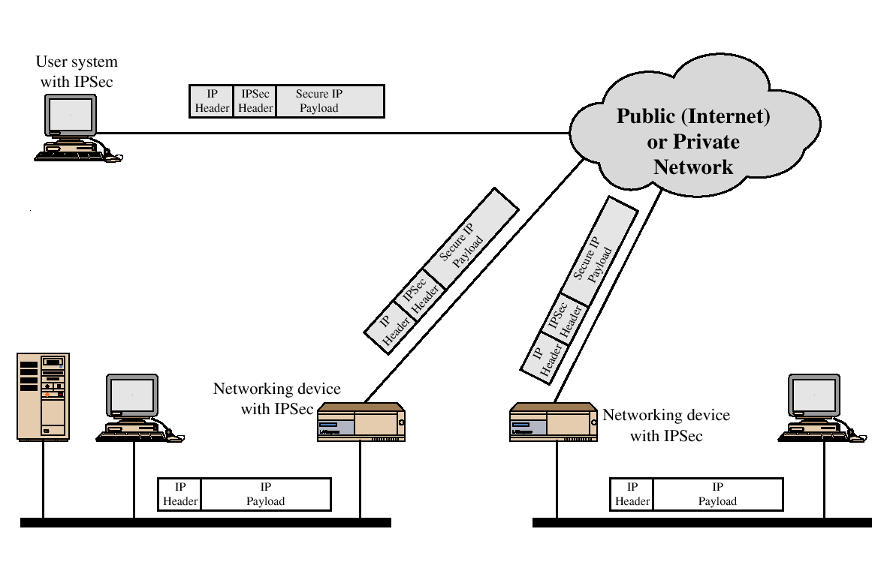
IPSec Scenario
End-to-End
Site-to-Site

Slide 110
IPSec Operation
Transport mode
Offers end-to-end encryption
Often used for remote access
End-devices must implement Ipsec
Tunnel mode
Often used between firewalls
Used to build Virtual Private Networks (VPN)
Encrypts all traffic over insecure networks

Slide 111
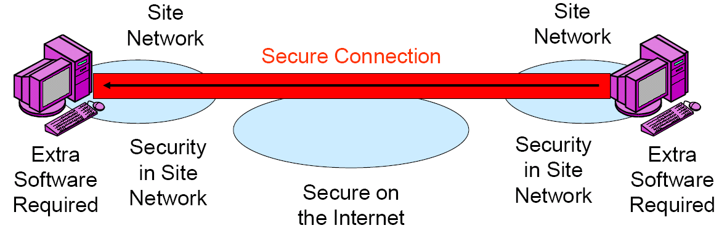
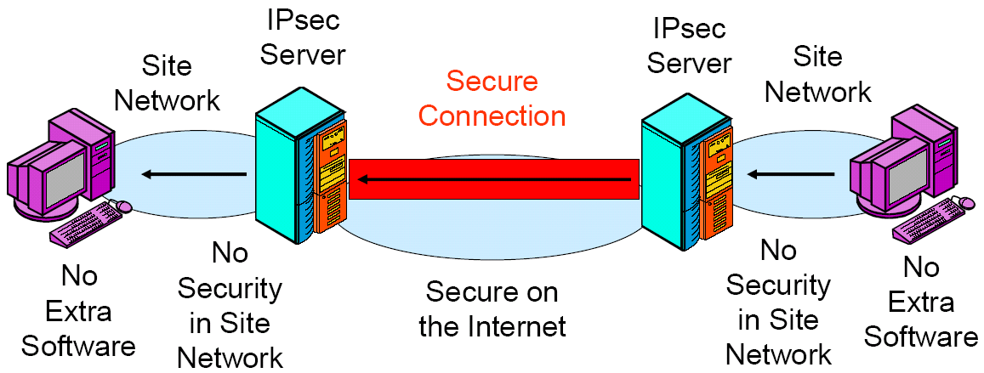
Transport Mode vs. Tunnel Model

Slide 112
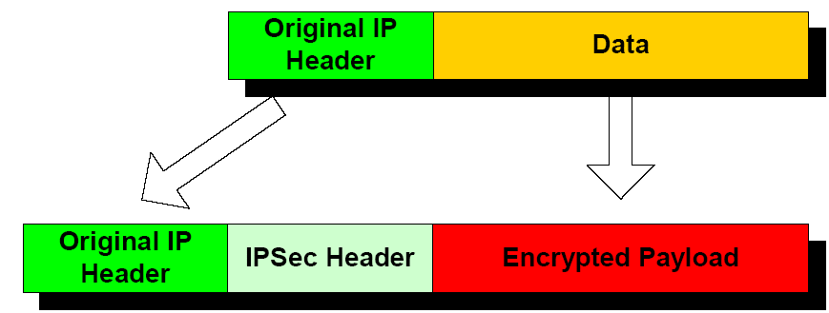
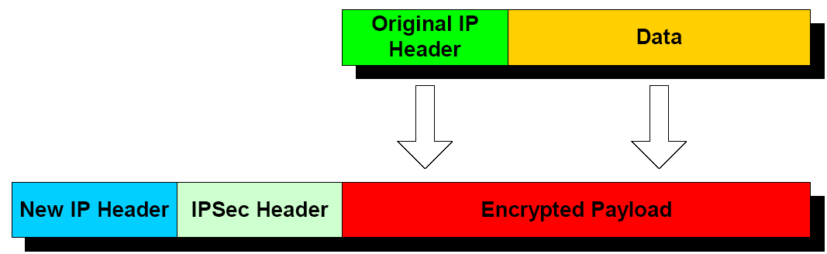
Tunnel and Transport Modes
Transport mode
Header IP addresses are actual addresses
Original IP header not protected
Tunnel mode
Header IP Addresses are IPSec Gateway Addresses
Host IP Address is not Revealed
Transport mode
Tunnel mode

Slide 113
IPsec protocols
Authentication protocol
Authentication Header (AH)
Does not encrypt messages
Combined authentication/encryption protocol
Encapsulating Security Payload (ESP)
Provides message confidentiality (encryption) plus authentication
Internet Key exchange protocol (IKE)
Negotiates security capabilities between two peers

Slide 114
Security Associations (SA)
The SA defines one-way relationships between sender and receiver
2 SAs are normally required for full duplex communication
The Security Parameters Index (SPI) tells under what SA a received packet be processed
Each host has a table containing the SAs
SPI is the index used to find the entry for a particular SA
The index is local for two peers (no global meanings)

Slide 115
SA Parameters
Sequence number counter
Sequence counter overflow
Anti-replay windows
AH info (auth. algorithm, keys, key lifetimes, etc.)
ESP info (encryption and auth. algorithm, keys, IV, key lifetimes, etc.)
Lifetime of this SA
IPsec protocol mode (tunnel, transport)
Path MTU (observed)

Slide 116
Internet Key Exchange (IKE)
Used to establish, modify and delete security associations (SAs)
RFC 2409, based on
ISAKMP (Internet Security Association Key Management Protocol)
Oakley Key Generation Protocol
IKE performs the following tasks
Agrees upon security algorithms
Authentication (Key-Hashed MAC)
Exchange of (symmetric) session crypto keys

Slide 117
ISAKMP
Internet Security Association and Key Management Protocol
2 phases procedure
Establish secure, authenticated channel (ISA)
Negotiate security parameters (KMP)
A general framework, exact details left to other protocols
Procedures and message formats defined

Slide 118
Oakley – Key Generation
Oakley extends Diffie-Hellman for key generation
Uses cookies to identify end systems
Enables predefined groups with fixed DH global parameters
Uses nonces against replay attacks
Oakley provides authentication
Digital signatures – signing of a hash with private key
Public-key encryption – using private key to encrypt random values
Symmetric key encryption – key delivered out-of-band
Notes:
Different types (levels) of authentication

Slide 119
IKE Procedure
ISAKMP merged with Oakley
ISAKMP provides the protocol framework
Oakley provides the security mechanisms
Phase 1 Example
Notes:
建立SA

Slide 120
IKE Procedure
Phase 2 Example
Notes:
Key exchange

Slide 121
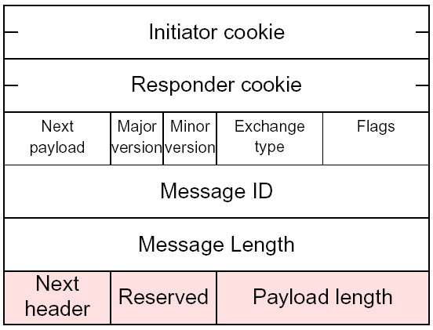
ISAKMP Header Format
Total

Slide 122
An ISAKMP Packet
0
8
16
31
Initiator cookie
Responder cookie
ISAKMP
Header
KE
Version
Exchange Type
Flags
Message ID
Total message length
Nonce
0
KE payload length
Key Exchange
KE payload
Defined by Oakley
KE payload data
0
0
Nonce payload length
Nonce payload data
Nonce payload

Slide 123
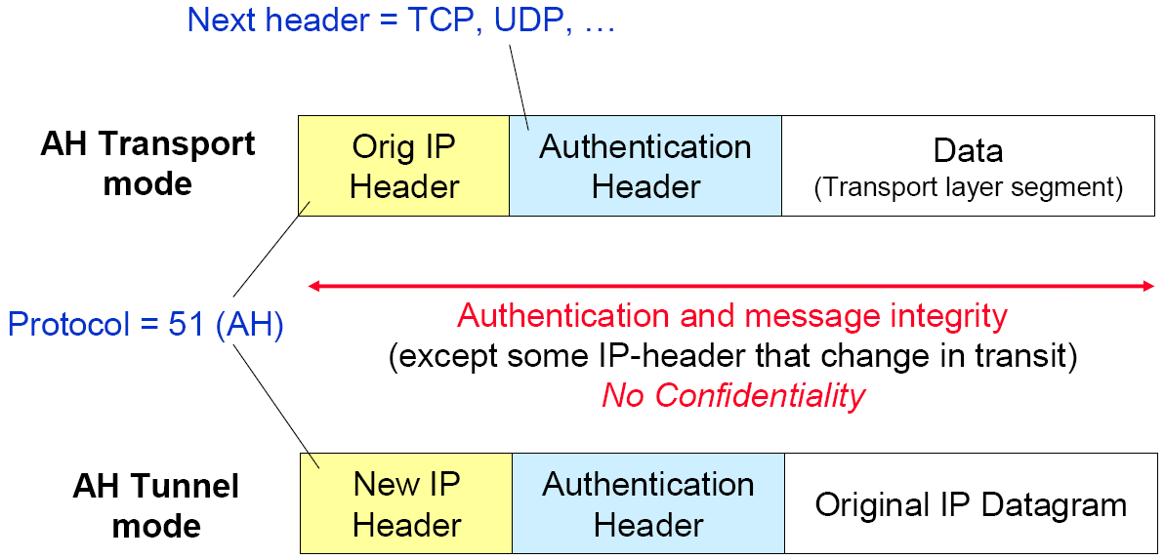
Authentication Header (AH) Protection
Changeable IP header fields: TTL, Header checksum
Predictable fields: Destination address (under source routing)
Unchangeable fields: Source address, header length
Notes:
Others: authentication data field in AH
Protocol = 51

Slide 124
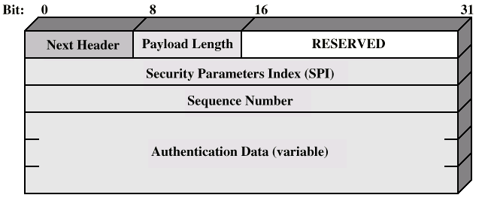
Authentication Header
Identify Security Association
Protect from replay attack
MAC code of IP packets
Payload length: AH length in 32 bits word (minus 2)

Slide 125
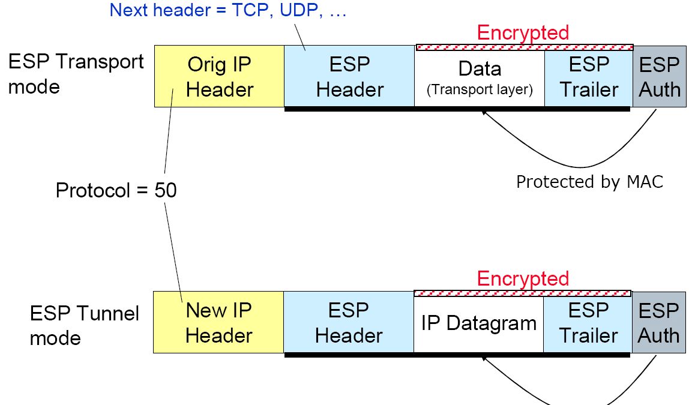
ESP Protection
Authenticated
Notes:
Protocol = 50

Slide 126
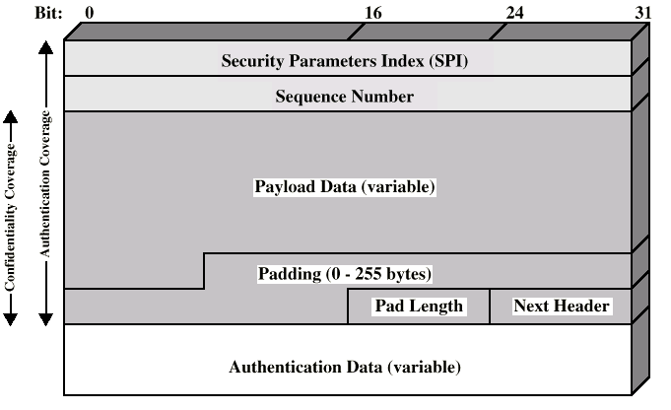
ESP Packet
ESP Header
ESP Trailer
Notes:
根据IP首部的总长字段确定“Next header”字段位置

Slide 127
ESP Trailer
Padding is used for
Making sure next header is properly aligned
May be necessary if cipher requires blocks of a certain size
May contain IV for the cipher
Random padding can also be used to make traffic analysis harder

Slide 128
Securing Wireless LANs
Securing 802.11
Authentication + Encryption
1st attempt: Wired Equivalent Privacy (WEP), failed
Current attempt: 802.11i
Wired Equivalent Privacy
Use shared key: 40-bit master key + 24-bit initialization vector (IV)
No key distribution mechanism, key set manually
Access point supposes only the mobile host has key
Notes:
Very simple

Slide 129
Wired Equivalent Privacy
Authentication
Mobile host requests authentication from access point
Access point sends back 128-bit nonce (against replay)
Host encrypts nonce using shared master key K_{S}
Access point decrypts nonce, authenticates host

Slide 130
Wired Equivalent Privacy
Encryption
40-bit K_{S} + 24-bit IV used to generate a stream of keys
Generator assures same key stream for similar 64-bit key
Key stream XOR’ed with plaintext and checksum to produce cipher text
For each octet of msg data d_{i}: c_{i} = k_{i} ⊕ d_{i}
For each octet of CRC crc_{j}: c_{n+j} = k_{n+1} ⊕ crc_{j}
IV and cipher text sent in frame
802.11 Header
IV
WEP encrypted data + CRC
Notes:
Master Key
A pseudo-random number generator

Slide 131
Attack WEP
Security hole
24-bit IV, one IV per frame
If assigned randomly, expected reuse once per 5000 frames
If assigned sequentially, reused at each startup
Attack is easy, since
Cipher text C is the same if IV reused
If Trudy causes Alice encrypt a known plain text P₁
P₂ will be known once the IV reappear

Slide 132
802.11i Improved Security
Uses authentication server separate from access point
Provides key distribution mechanism
Numerous (stronger) forms of encryption possible

Slide 133
802.11i Procedure
MH:
client station
AP: access point
AS:
Authentication
server
wired
network
1 Discovery of
security capabilities
2
MH and AS mutually authenticate, together
generate Master Key (K_{S}). AP serves as “pass through”
3
MH derives
similar K_{S}
3
AS sends K_{S} to AP
MH, AP use K_{S} to derive Temporal Key (TK) used for message encryption, integrity
4
Notes:
PMK: Pairwise Master Key

Slide 134
EAP: Extensible Authentication Protocol
EAP: end-end client (mobile) to authentication server protocol
EAP sent over separate “links”
Mobile-to-AP (EAP over LAN)
AP to authentication server (RADIUS over UDP)
RADIUS: Remote Authentication Dial In User Service
Provides centralized Authentication, Authorization, and Accounting
wired
network
EAP TLS
EAP
EAP over LAN (EAPoL)
RADIUS
IEEE 802.11
UDP/IP
Notes:
Transport Layer Security

Slide 135




Firewalls
Isolate organization’s intranet from larger Internet
Allowing some packets to pass, blocking others
Ensure intranet/system security from hackers/malwares outside
administered
network
public
Internet
firewall

Slide 136
Functions of Firewalls
Prevent denial of service attacks
SYN flooding, by preventing attackers from establishing bogus TCP connections / trying pings
Allow only authorized access to inside network
Set of authenticated users/hosts
Prevent illegal access/modification of internal data
Prevent access of specified servers/applications

Slide 137
Packet Filtering
Router firewall
Check if arriving packet be allowed in, departing packet let out
Router firewall filters packet-by-packet, decision to forward/drop packet based on:
Source IP address, destination IP address
TCP/UDP source and destination port numbers
ICMP message type
TCP SYN and ACK bits

Slide 138
Filtering Example
Block incoming/outgoing datagrams with IP protocol field = 17
All incoming, outgoing UDP flows are blocked
Block incoming/outgoing datagrams with either source or dest port = 23
All telnet connections (bbs) are blocked
Block incoming TCP segments with ACK=0
Prevents external clients from making TCP connections to internal hosts (i.e. DOS attacks)

Slide 139
More Examples
Policy | Firewall Setting
No outside Web access. | Drop all outgoing packets to any IP address, port 80
No incoming TCP connections, except those for institution’s public Web server only. | Drop all incoming TCP SYN packets to any IP except 130.207.244.203, port 80
Prevent Web-radios from eating up the available bandwidth. | Drop all incoming UDP packets - except DNS and router advertisements.
Prevent your network from being used for a smurf DoS attack. | Drop all ICMP packets going to a “broadcast” address (eg 130.207.255.255).
Prevent your network from being tracerouted | Drop all outgoing ICMP TTL expired traffic

Slide 140
ACL: Access Control List
action | source address | dest address | protocol | source port | dest port | flag bit
allow | 222.22/16 | outside of 222.22/16 | TCP | > 1023 | 80 | any
allow | outside of 222.22/16 | 222.22/16 | TCP | 80 | > 1023 | ACK
allow | 222.22/16 | outside of 222.22/16 | UDP | > 1023 | 53 | ---
allow | outside of 222.22/16 | 222.22/16 | UDP | 53 | > 1023 | ----
deny | all | all | all | all | all | all

Slide 141
A Stateful ACL
Keeps in mind states of TCP connections or UDP timeouts
A stateful ACL
action | source address | dest address | proto | source port | dest port | flag bit | is closed
allow | 222.22/16 | outside of 222.22/16 | TCP | > 1023 | 80 | any
allow | outside of 222.22/16 | 222.22/16 | TCP | 80 | > 1023 | ACK | x
allow | 222.22/16 | outside of 222.22/16 | UDP | > 1023 | 53 | ---
allow | outside of 222.22/16 | 222.22/16 | UDP | 53 | > 1023 | ---- | x
deny | all | all | all | all | all | all
Notes:
Preventing replay attacks

Slide 142

More Advanced: Application Gateways
Filters packets on application data as well as on IP/TCP/UDP fields
e.g. allow select internal users to telnet outside
IDS: intrusion detection system
TCP connections must be relayed by gateway
Router filter blocks all TCP connections not originating from gateway
gateway-to-remote
host telnet session
host-to-gateway
telnet session
application
gateway
router and filter
Notes:
IDS with multiple sensors

Slide 143
Firewall: In Conclusion
3 types
Stateless packet filters
Stateful packet filters
Application gateways
Many things to do
Gateway is the most powerful, but not transparent (by proxy setting)
Limited functions for UDP communications
Setting rules is always a step later

Slide 144
Chapter Goals
Understand principles of network security
Cryptography and its many uses beyond “confidentiality”
Authentication and Message integrity
Key distribution
Network Security in Practice
TSL and IPSec
Wireless LAN security
Firewall

